Slide 1


Hiring Process Analytics
Analyse the company's hiring process data and draw meaningful insights from it that can help the company improve it’s hiring process.
By Ashutosh Singh

Slide 2
Project Description
This project is about anlaysing company’s hiring process data from the given dataset containing records of prevous hires .
Hiring process is an important function of a company and through proper analysis the comapny gets to know about the major underlying trends thus ,can make informed decisions
Here, as a DATA ANALYST , I’ll be using my EXCEL and Statistics skills to analyse trends like salary distribution , hiring, rejection , postion tiers, department strength etc that will help the company to take impactful decisions like what salary to offer ,gender balacing ,which department lacks or excells etc .

Slide 3
Approach
Obtain and Understand the data(click here to obtain the data-set) After obtaining the data one must take time to understand and be familiar with it. This will help in identifying any potential issues or challenges with the analyst and thus ,will be addressed accordingly.
Prepare data- Check and Handle Missing data Ensure to check for any missing data or blank values in the data-set provided. If there are, decide on the best strategy to handle them.
Identify your audience Before starting the analysis, you need to understand who your audience is, what they care about, and what they need to know. This will help you tailor your content, style, and tone to suit their preferences and expectations.
Check & Handle Outliers Outliers are data points that are far from other data points and can distort statistical results. So, it’s important to handle them either by treating them as separate cases or by excluding them.
Analyse the data Here, analysis of the filtered data is done as per requirements.
Summarise the data Once the analysis is completed, the data is presented to the audience in a lucid and concise way using charts, graphs etc. stating the methodology and key findings.

Slide 4



Tech-Stack Used
1
Microsoft Excel
To explore, clean, analyse and
visualise the data.
Microsoft Power Point
To prepare and present this report.
2

Slide 5
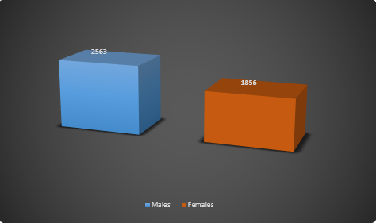

Hiring Analysis: Determine the gender distribution of hires. How many males and females have been hired by the company?
According to the data, the no. of Males and Females hired are 2563 and 1856 respectively.
This shows that more Males are hired than females.

Slide 6

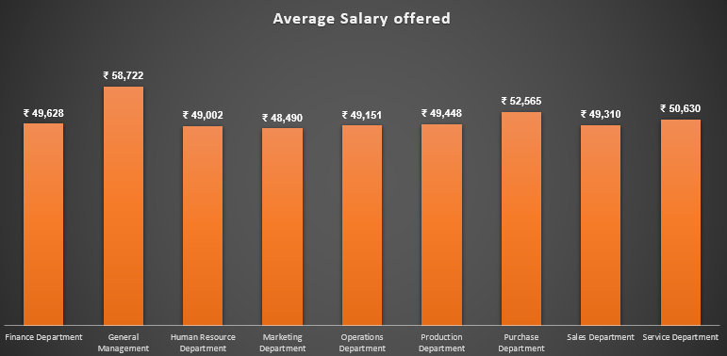
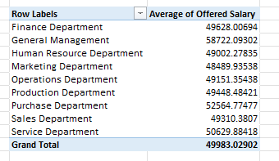
B. Salary Analysis: What is the average salary offered by this company? Use Excel functions to calculate this.
The overall average salary offered is Rs.49983 while the departmental average salary is shown above where General Management department has the highest av.salary i.e.,Rs.58722.
The outliers are ignored here as they don’t affect the result.

Slide 7
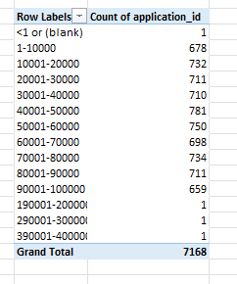
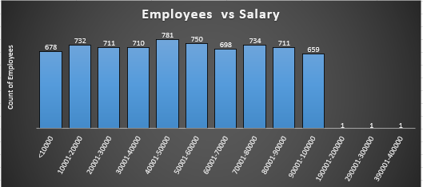
C. Salary Distribution: Create class intervals for the salaries in the company to understand the salary distribution.
₹
The range of ₹40,000- ₹ 50,000 has maximum number of employees i.e., 781.
Again, Outliers are ignored here.

Slide 8
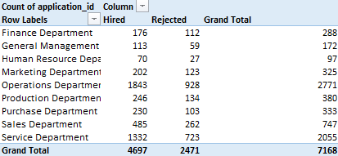
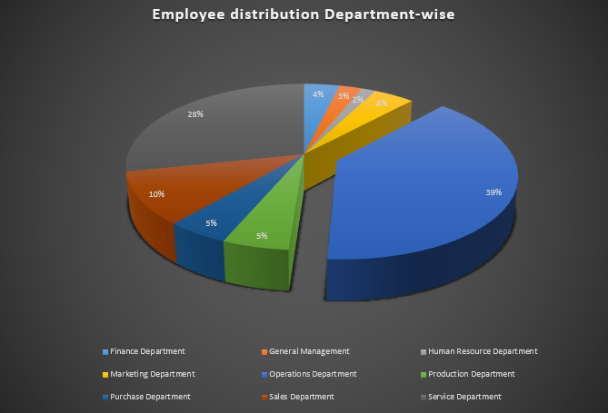
D. Departmental Analysis:
Use a pie chart, bar graph to show the proportion of people working in different departments.
Operation Department has the maximum wokforce of 39%.
Service Department comes second with 28% of the workforce.

Slide 9
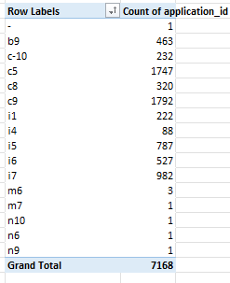
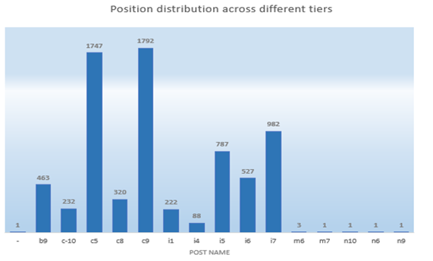
E. Position Tier Analysis:
Use a chart or graph to represent the different position tiers within the company to understand the distribution of positions across different tiers.
C5 & C9 posts are the most common.
Posts like M7,N10,N6,N9 are the scarse one.

Slide 10
Insights
1
More Males are hired than Females.
The number of Males and Females hired are 2563 and 1856 respectively.
The overall average salary
offered is Rs.49983
2
3
Employees with salary range of ₹40,000-
₹ 50,000 are maximum i.e., 781
Operation Department has the maximum wokforce of 39%.
4
5
Most common posts are C5 & C9

Slide 11
Thank You!

